Slide 1
ACT for Psychosis Workshop
Eric Morris Ross White
Neil Thomas Gordon Mitchell
Joe Oliver
July 2013, ACBS World Conference
Sydney, Australia

Slide 2
Our Educational Objectives
After this session, you can:
Explain how ACT can be a pragmatic treatment in fostering recovery from psychosis, using individual, group and systems-wide interventions.
Conceptualise the problems of psychosis using the ACT model.
Utilize ACT metaphors and exercises adapted for treatment of psychosis.

Slide 3
Workshop Plan
Part 1 – Introducing ACT for Psychosis
Part 2 – Assessment, Formulation & Engagement
Part 3 – ACTp interventions - General Overview
Part 4 - Innovations

Slide 4
Your experience
What work are you doing with people who have experienced psychosis?
Using:
mindfulness?
A recovery approach?
values/ committed action?
Difficulties encountered?

Slide 5
Be here now
Open
Aware
Active
Open up
Know what matters
Psychological Flexibility
Watch your thinking
Do what works
Pure awareness

Slide 6
MINDFULNESS
Present moment awareness training
Untangling from difficult thought and emotion
Finding your resilient sense of self
VALUES-BASED ACTION
Clarifying your most valued life directions
Using values as a guide to goals and daily behaviour
From: Flaxman, 2011

Slide 7
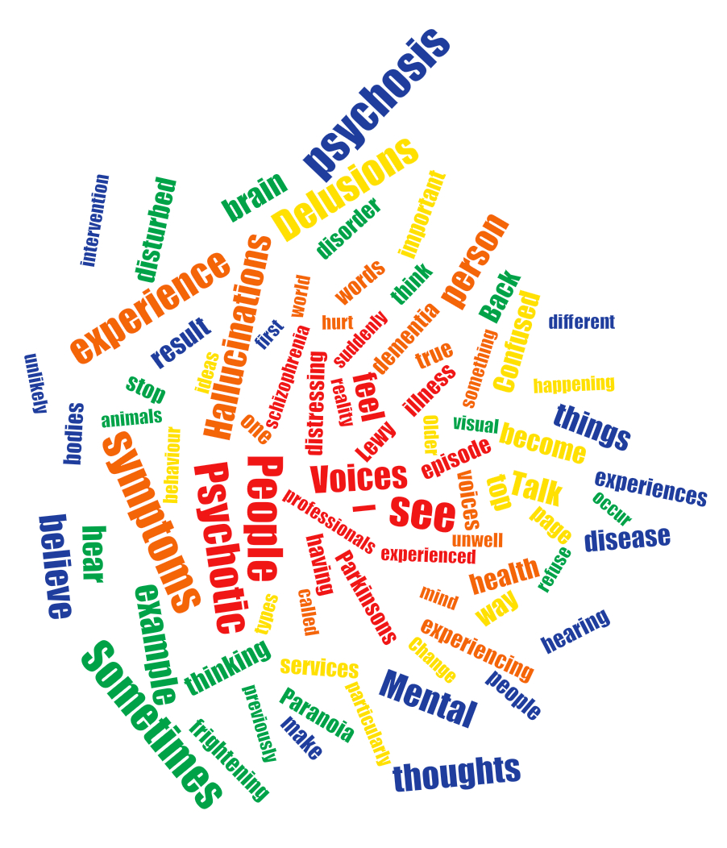

Slide 8
A Psychological View of Psychosis
Dimensional rather than categorical: Normalising
Work with symptoms rather than diagnoses
Diagnoses lack scientific/ pragmatic validity – “schizophrenia” is less useful than understanding behaviour in context
Biological vulnerabilities undoubtedly contribute, however symptoms/behaviour are heavily influenced by the environment

Slide 9
We work with whole human beings whose behaviour is influenced by context

Slide 10
Continuum Model of Psychosis
Delusions and hallucinations may be considered on a continuum with “normal” psychological phenomena (Johns & van Os, 2001)
Delusional beliefs result from attempts to make sense of anomalous experiences (Maher, 1988)
People can experience unusual ideas and hallucinations in sensory/ sleep deprivation, stress, isolation etc

Slide 11
Exercise: Hearing comments while noticing your values

Slide 12
Part of the rationale: what people do with unusual experiences
Notes:
12

Slide 13
Why ACT for Psychosis?
Symptoms lend themselves to ACT approach:
Anomalous experiences – primary experiences that are not easily changed
Unusual nature of experience either:
Encourage focus (search for meaning, understanding, personally salient)
Leads to suppression / avoidance (scary, unwanted, socially inappropriate)
Thinking style (jumping to conclusions, inflexibility)
Negative symptoms
Notes:
13

Slide 14
Experiential avoidance, fusion and psychosis
People who cope poorly with voices use more distraction and thought-suppression strategies (Romme and Escher, 1993).
Acceptance & mindfulness in voice hearers associated with less distress, voices appraised as less powerful (Morris et al., submitted); accepting voices associated with less compliance with harmful commands (Shawyer et al., 2007)
People with schizophrenia use less acceptance compared to suppression and reappraisal strategies. Acceptance is related to better psychosocial outcomes (Perry et al, 2010).
Notes:
14

Slide 15
Experiential avoidance & fusion 2
The tendency to accept experiences without judging them has a causal impact on changes in delusional distress over time (Oliver et al, 2011).
Psychological flexibility is negatively associated with depression and anxiety following a psychotic episode (White et al., 2012)
Over time, experiential acceptance shows positive associations with quality of life and affect for people with schizophrenia (Vilardaga, Hayes & Atkins, 2013).
Notes:
15

Slide 16
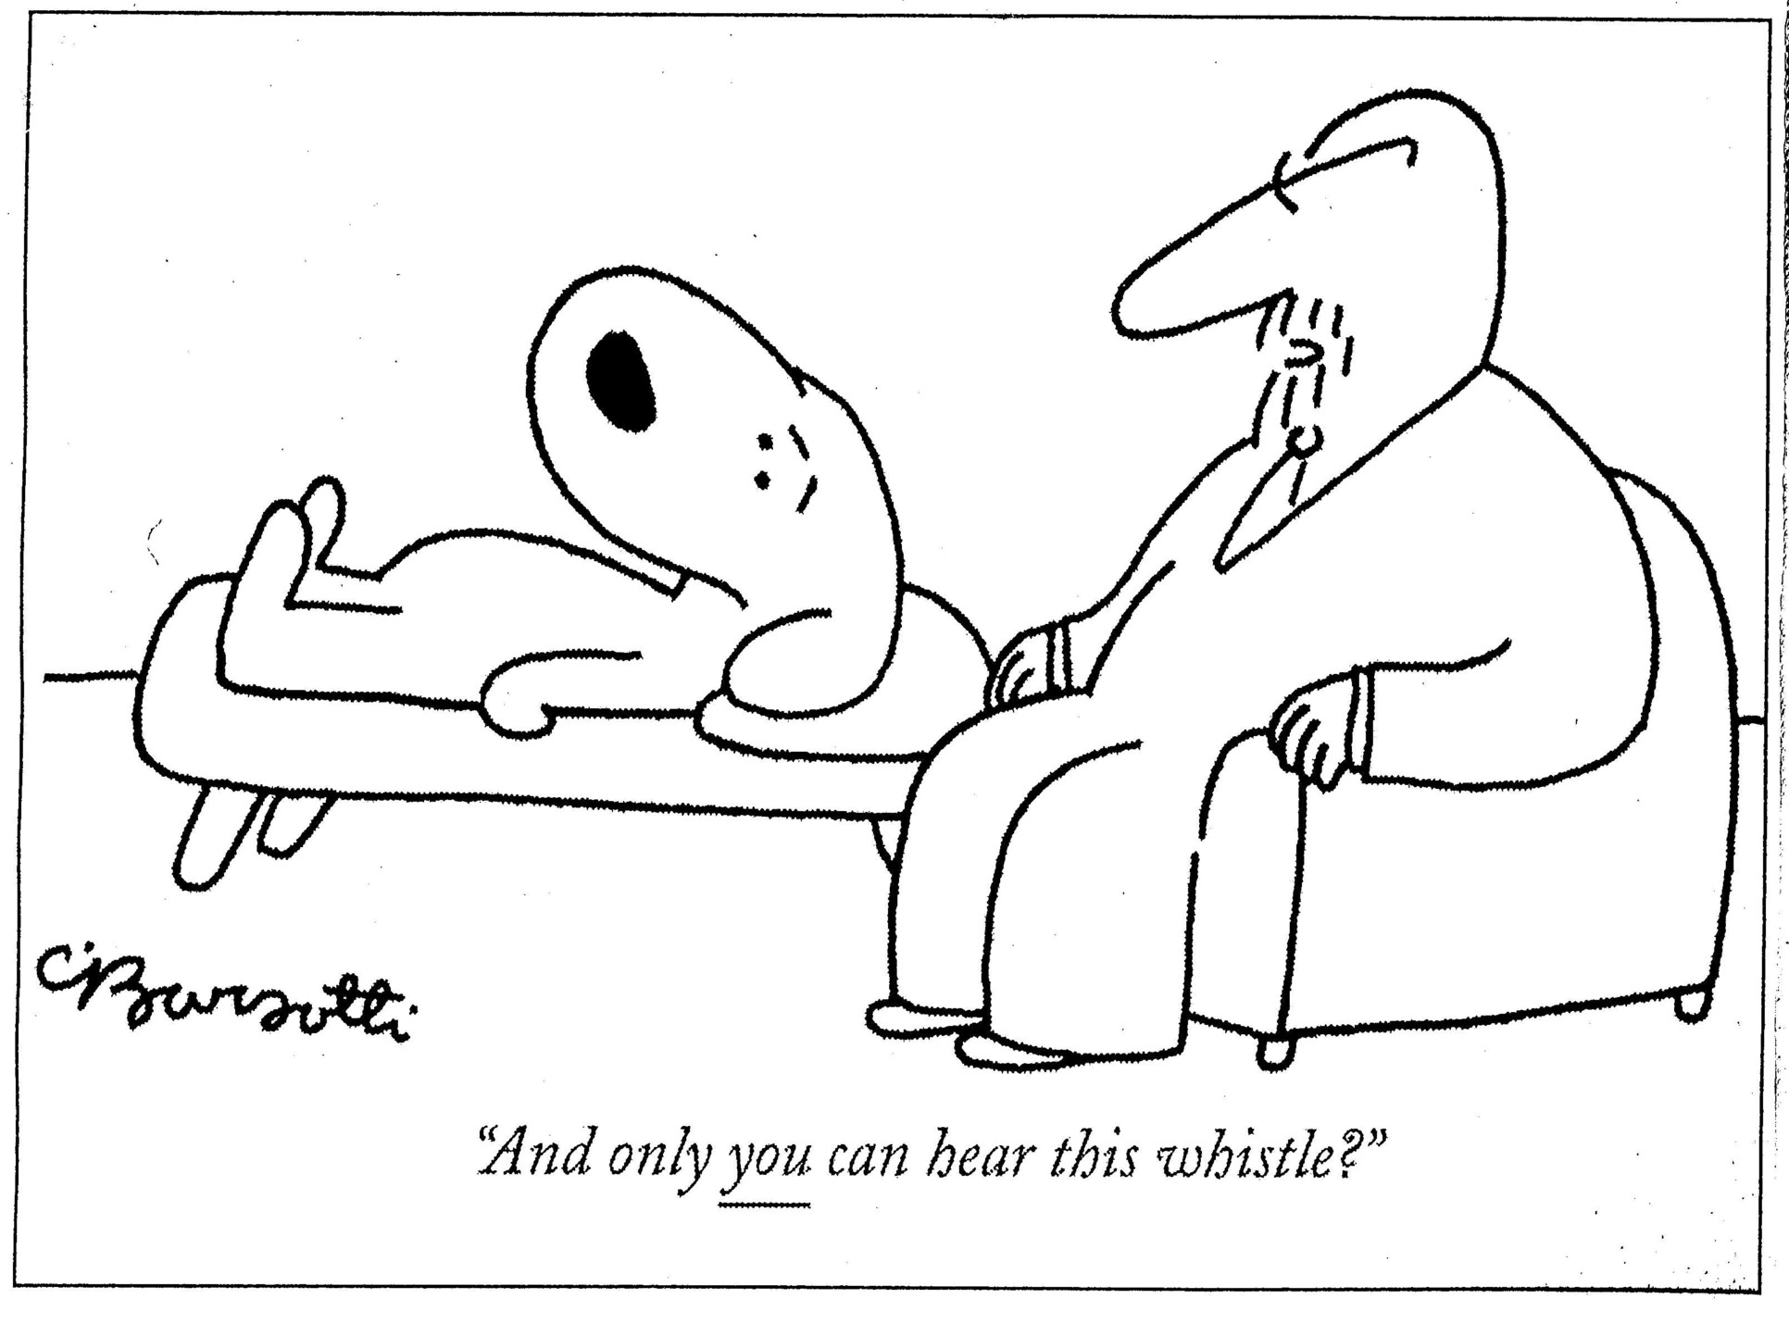

Slide 17
Impact rather than presence
The unusual/ intrusive experience, or the feared outcomes of it, as targets for avoidance = increasing impact
Fusion with the content of experiences, guiding choice and action = increasing impact
Negative symptoms – a possible outcome of chronic avoidance? (limited social reinforcement)
Notes:
17

Slide 18
Private
Event
V
A
L
U
I
N
G
Escaping
&
Avoiding
Clinging
&
Craving
Based on: Dahl, 2009

Slide 19
ACT, mindfulness and psychosis
Changing the relationship to private events (rather than directly changing content) to increase behavioural flexibility (e.g., Pérez-Álvarez et al., 2008)
Psychotic symptoms as an one experience of self, not the self (Chadwick, 2006)
We are focused on this whole person acting in context, rather than a set of symptoms.
Notes:
19

Slide 20
The ACT Stance
Recovery focus rather than symptom elimination
Central aim to address functioning & quality of life rather than assume that psychosis/emotions are the problem
Sessions often aim to hit multiple points on model

Slide 21
ACT & Recovery
ACT provides an evidence-based technology for doing therapy consistent with Recovery Principles
ACT uses personal values to guide therapeutic focus, emphasis on functioning and life meaning.
Therapy is defined by what the person wants to be doing with their lives.
Morris, 2012

Slide 22
Recovery Principle | The ACT approach
Finding and maintaining hope | Hope is an active stance we can take. Feelings may come and go; our hopeful actions are a way we can change our world.
Encouraging self management | Our actions and choices can be judged by whether they are taking us in the direction of our values, rather than whether they are “right”, “make sense” or “look cool”. Learning from experience.
The re-establishment of a positive identity | Encourages contact with self as awareness, noticing the process of how our minds create stories about us. Instead of being entangled in the mind’s judgements, we observe whether they are useful for our chosen life directions.
Finding meaning in life | Life’s pain can be dignified if it is a part of doing the things that are important to us. Through acting on personal values, contact with meaning is increased.
Taking responsibility for one’s life | We help people to be “response-able”: to act on their values rather than their fear, through developing an open, compassionate stance toward their own experiences & themselves.

Slide 23
